Slide 1
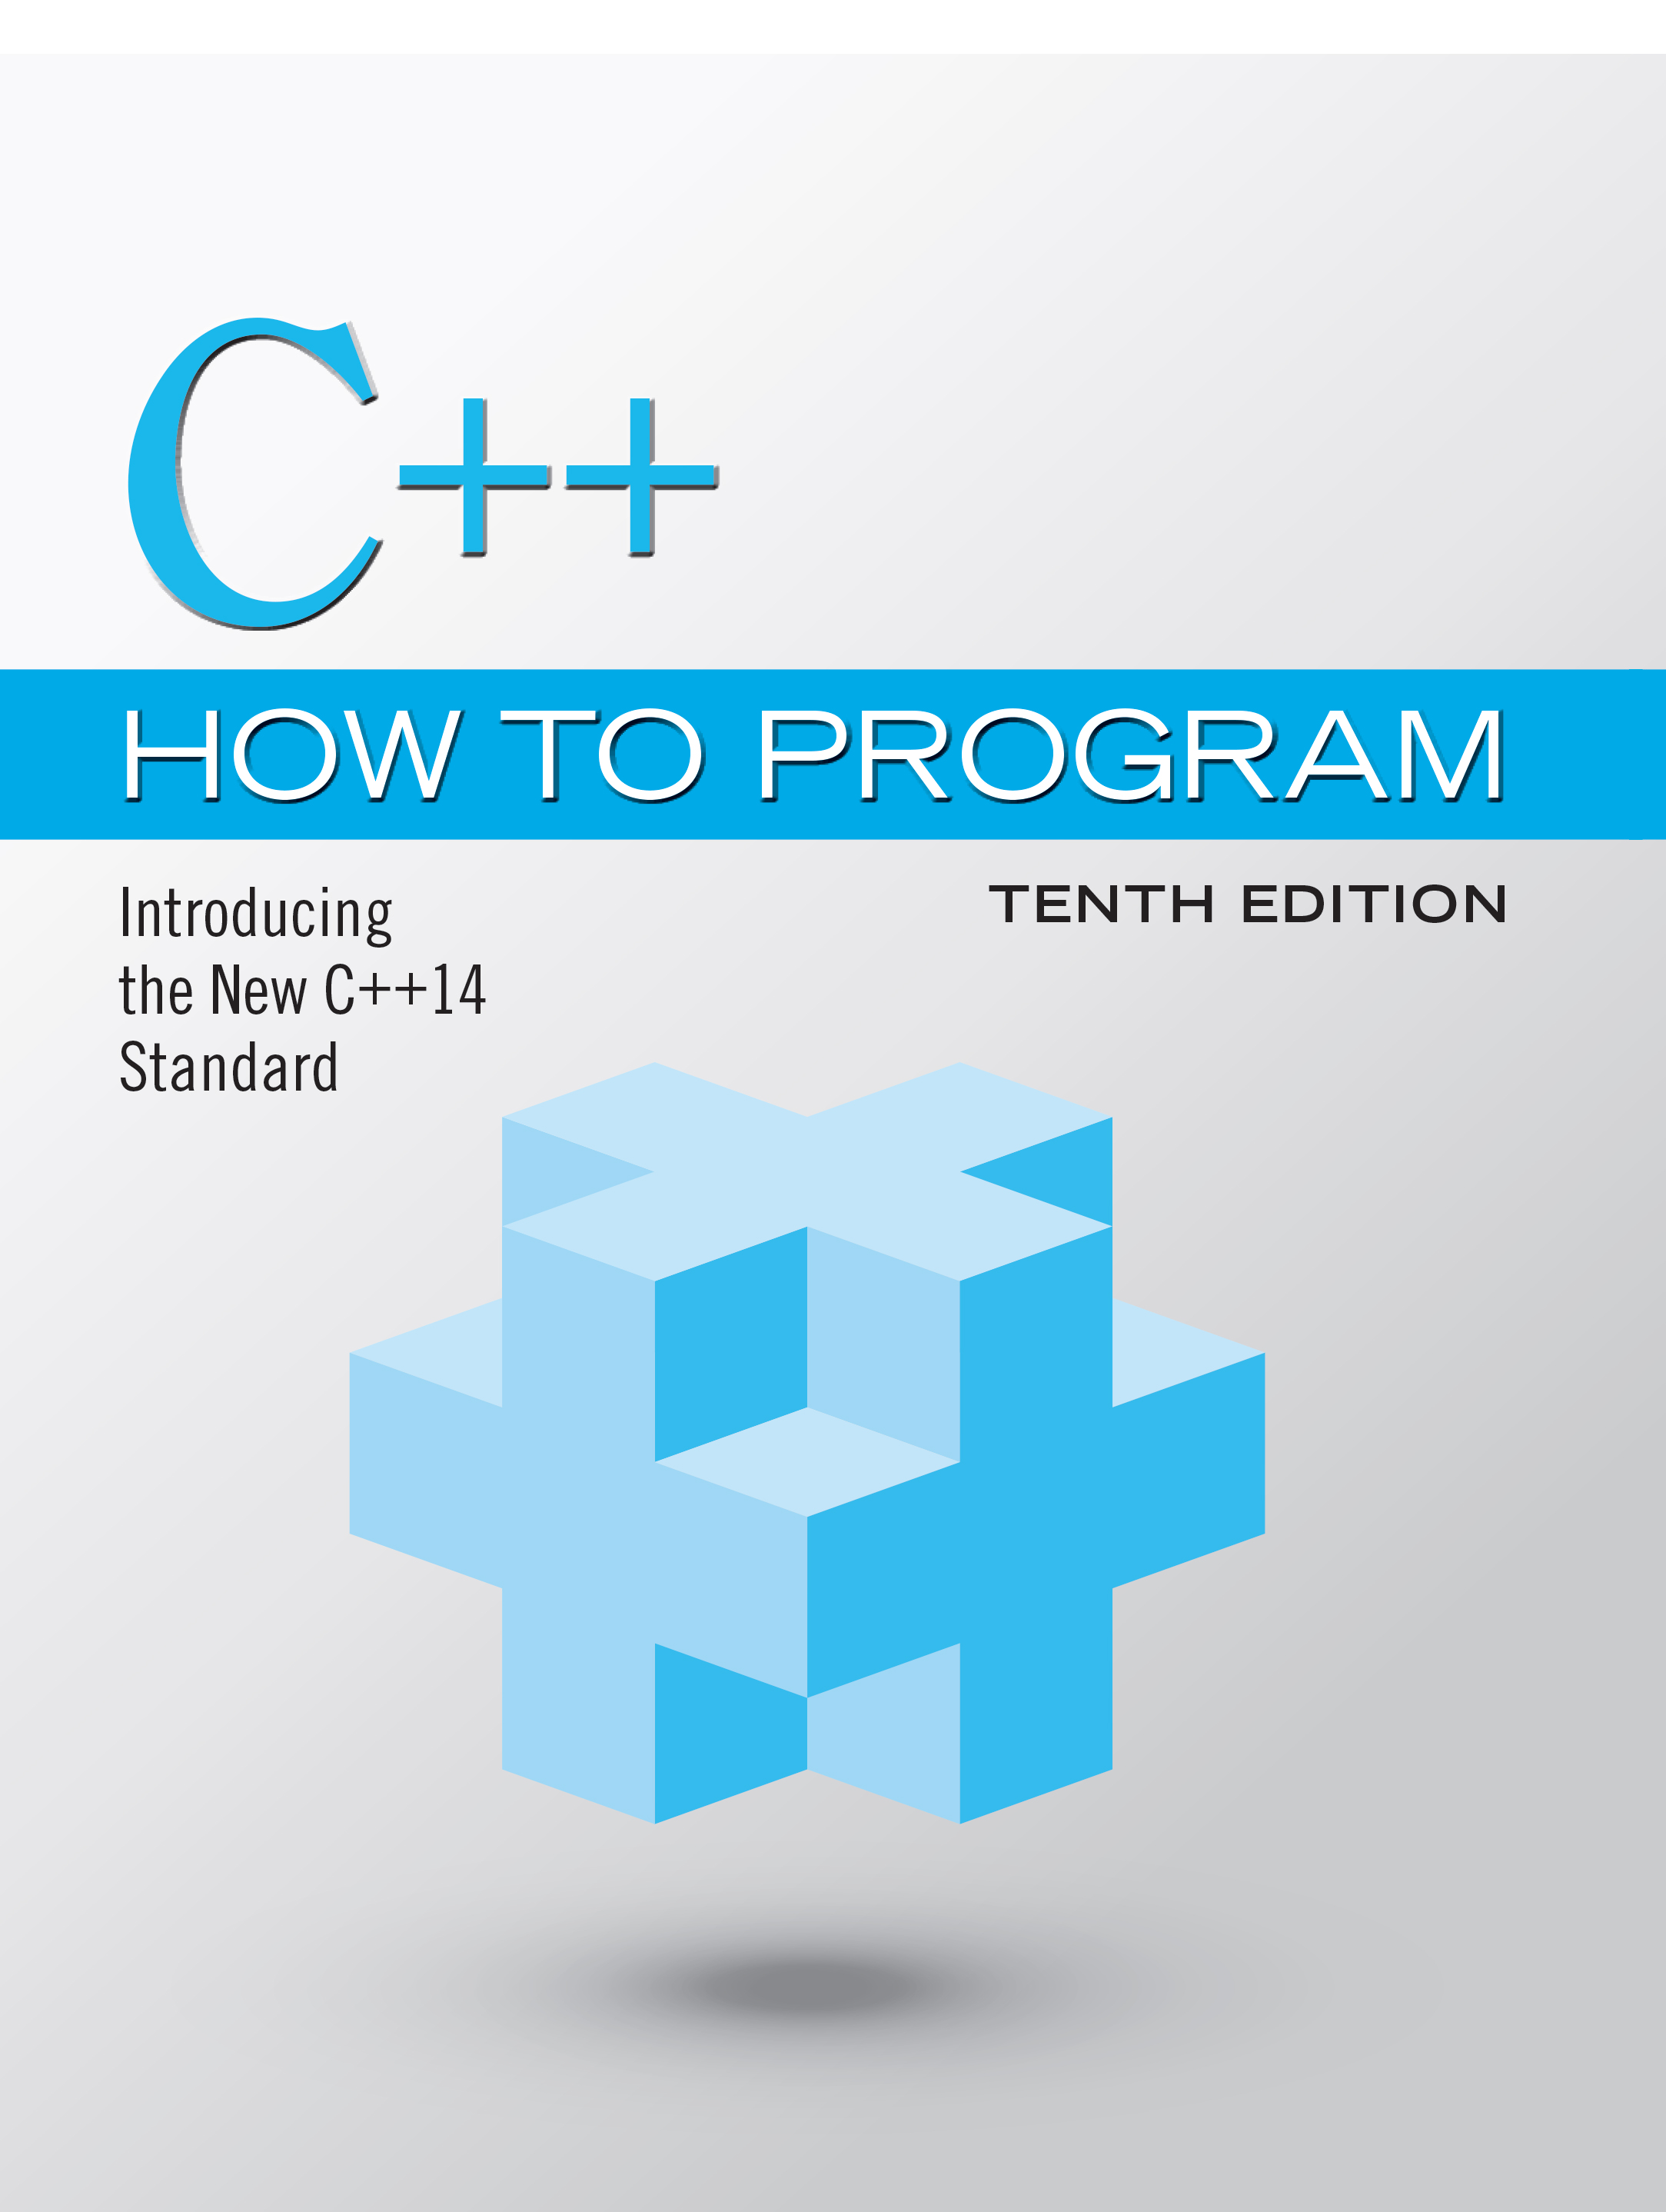
C++ How to Program: Introducing the New C++14 Standard
Tenth Edition
Chapter 1
Introduction to Computers and C++
Slides in this presentation contain hyperlinks. JAWS users should be able to get a list of links by using INSERT+F7
Copyright © 2017, 2014, 2012 Pearson Education, Inc. All Rights Reserved
Notes:
If this PowerPoint presentation contains mathematical equations, you may need to check that your computer has the following installed:
1) MathType Plugin
2) Math Player (free versions available)
3) NVDA Reader (free versions available)

Slide 2
Learning Objectives
Exciting recent developments in the computer field.
Computer hardware, software and networking basics.
The data hierarchy.
The different types of programming languages.
Basic object-technology concepts.
Some basics of the Internet and the World Wide Web.
A typical C++ program development environment.
To test-drive a C++ application.
Some key recent software technologies.
How computers can help you make a difference.

Slide 3
Outline (1 of 3)
1.1 Introduction
1.2 Computers and the Internet in Industry and Research
1.3 Hardware and Software
1.3.1 Moore’s Law
1.3.2 Computer Organization
1.4 Data Hierarchy
1.5 Machine Languages, Assembly Languages and High-Level Languages
1.6 C and C++

Slide 4
Outline (2 of 3)
1.7 Programming Languages
1.8 Introduction to Object Technology
1.9 Typical C++ Development Environment
1.10 Test-Driving a C++ Application
1.10.1 Compiling and Running an Application in Visual Studio 2015 for Windows
1.10.2 Compiling and Running Using G N U C++ on Linux
1.10.3 Compiling and Running with X code on Mac O S X

Slide 5
Outline (3 of 3)
1.11 Operating Systems
1.11.1 Windows—A Proprietary Operating System
1.11.2 Linux—An Open-Source Operating System
1.11.3 Apple’s O S X; Apple’s i O S for iPhone®, iPad® and iPod Touch® Devices
1.11.4 Google’s Android
1.12 The Internet and the World Wide Web
1.13 Some Key Software Development Terminology
1.14 C++11 and C++14: The Latest C++ Versions
1.15 Boost C++ Libraries
1.16 Keeping Up to Date with Information Technologies

Slide 6
1.1 Introduction (1 of 2)
C++—a powerful computer programming language that’s appropriate for technically oriented people with little or no programming experience, and for experienced programmers to use in building substantial information systems.
You’ll write instructions commanding computers to perform those kinds of tasks.
Software (i.e., the instructions you write) controls hardware (i.e., computers).
You’ll learn object-oriented programming—today’s key programming methodology.
You’ll create many software objects in the real world.

Slide 7
1.1 Introduction (2 of 2)
C++ is one of today’s most popular software development languages.
C++ is one of today’s most popular software development languages.
C++11 and C++14 are the latest versions standardized through the International Organization for Standardization (I S O) and the International Electrotechnical Commission (I E C).

Slide 8
1.2 Computers and the Internet in Industry and Research
Many of the most influential and successful businesses of the last two decades are technology companies, including Apple, I B M, Hewlett Packard, Dell, Intel, Motorola, Cisco, Microsoft, Google, Amazon, Facebook, Twitter, eBay and many more.
These companies are major employers of people who study computer science, computer engineering, information systems or related disciplines.

Slide 9
Figure 1.1 A Few Uses for Computers (1 of 5)
Name | Description
Electronic health records | These might include a patient's medical history, prescriptions, immunizations, lab results, allergies, insurance information and more. Making this information available to health care providers across a secure network improves patient care, reduces the probability of error and increases overall efficiency of the health-care system, helping control costs.
Human Genome Project | The Human Genome Project was founded to identify and analyze the 20,000+ genes in human D N A. The project used computer programs to analyze complex genetic data, determine the sequences of the billions of chemical base pairs that make up human D N A and store the information in databases which have been made available over the Internet to researchers in many fields.
AMBER™ Alert | The A M B E R (America’s Missing: Broadcast Emergency Response) Alert System is used to find abducted children. Law enforcement notifies T V and radio broadcasters and state transportation officials, who then broadcast alerts on T V, radio, computerized highway signs, the Internet and wireless devices. A M B E R Alert recently partnered with Facebook, whose users can “Like” A M B E R Alert pages by location to receive alerts in their news feeds.

Slide 10
Figure 1.1 A Few Uses for Computers (2 of 5)
Name | Description
World Community Grid | People worldwide can donate their unused computer processing power by installing a free secure software program that allows the World Community Grid (http://www.worldcommunitygrid.org) to harness unused capacity. This computing power, accessed over the Internet, is used in place of expensive supercomputers to conduct scientific research projects that are making a difference—providing clean water to third-world countries, fighting cancer, growing more nutritious rice for regions fighting hunger and more.
Cloud Computing | Cloud computing allows you to use software, hardware and information stored in the “cloud”—i.e., accessed on remote computers via the Internet and available on demand—rather than having it stored on your personal computer. These services allow you to increase or decrease resources to meet your needs at any given time, so they can be more cost effective than purchasing expensive hardware to ensure that you have enough storage and processing power to meet your needs at their peak levels. Using cloud-computing services shifts the burden of managing these applications from the business to the service provider, saving businesses money.

Slide 11
Figure 1.1 A Few Uses for Computers (3 of 5)
Name | Description
Medical imaging | X-ray computed tomography (C T) scans, also called C A T (computerized axial tomography) scans, take X-rays of the body from hundreds of different angles. Computers are used to adjust the intensity of the X-rays, optimizing the scan for each type of tissue, then to combine all of the information to create a 3D image. M R I scanners use a technique called magnetic resonance imaging, also to produce internal images noninvasively.
G P S | Global Positioning System (G P S) devices use a network of satellites to retrieve location-based information. Multiple satellites send time-stamped signals to the G P S device, which calculates the distance to each satellite, based on the time the signal left the satellite and the time the signal arrived. This information helps determine the device’s exact location. G P S devices can provide step-by-step directions and help you locate nearby businesses (restaurants, gas stations, etc.) and points of interest. G P S is used in numerous location-based Internet services such as check-in apps to help you find your friends (e.g., Foursquare and Facebook), exercise apps such as RunKeeper that track the time, distance and average speed of your outdoor jog, dating apps that help you find a match nearby and apps that dynamically update changing traffic conditions.

Slide 12
Figure 1.1 A Few Uses for Computers (4 of 5)
Name | Description
Robots | Robots can be used for day-to-day tasks (e.g., iRobot’s Roomba vacuuming robot), entertainment (e.g., robotic pets), military combat, deep sea and space exploration (e.g., N A S A’s Mars rover Curiosity) and more. RoboEarth (www.roboearth.org) is “a World Wide Web for robots.” It allows robots to learn from each other by sharing information and thus improving their abilities to perform tasks, navigate, recognize objects and more.
E-mail, Instant Messaging, Video Chat and F T P | Internet-based servers support all of your online messaging. E-mail messages go through a mail server that also stores the messages. Instant Messaging (I M) and Video Chat apps, such as Facebook Messenger, A I M, Skype, Yahoo! Messenger, Google Hangouts, Trillian and others allow you to communicate with others in real time by sending your messages and live video through servers. F T P (file transfer protocol) allows you to exchange files between multiple computers (for example, a client computer such as your desktop and a file server) over the Internet.

Slide 13
Figure 1.1 A Few Uses for Computers (5 of 5)
Name | Description
Internet T V | Internet T V set-top boxes (such as Apple T V, Android T V, Roku and TiVo) allow you to access an enormous amount of content on demand, such as games, news, movies, television shows and more, and they help ensure that the content is streamed to your T V smoothly.
Streaming music services | Streaming music services (such as Apple Music, Pandora, Spotify, Last.fm and more) allow you listen to large catalogues of music over the web, create customized “radio stations” and discover new music based on your feedback.
Game programming | Global video-game revenues are expected to reach $107 billion by 2017 (http://www.polygon.com/2015/4/22/8471789/worldwide-video-games-market-value-2015). The most sophisticated games can cost over $100 million to develop, with the most expensive costing half a billion dollars (http://www.gamespot.com/gallery/20-of-the-most-expensive-games-ever-made/2900-104/). Bethesda’s Fallout 4 earned $750 million in its first day of sales (http://fortune.com/2015/11/16/fallout4-is-quiet-best-seller/)!

Slide 14
1.3 Hardware and Software (1 of 3)
Computers can perform calculations and make logical decisions phenomenally faster than human beings can.
Today’s personal computers can perform billions of calculations in one second—more than a human can perform in a lifetime.
Supercomputers are already performing thousands of trillions (quadrillions) of instructions per second!

Slide 15
1.3 Hardware and Software (2 of 3)
Computers process data under the control of sequences of instructions called computer programs.
These programs guide the computer through ordered actions specified by people called computer programmers.
The programs that run on a computer are referred to as software.
You’ll learn a key programming methodology that’s enhancing programmer productivity, thereby reducing software-development costs—object-oriented programming.

Slide 16
1.3 Hardware and Software (3 of 3)
A computer consists of various devices referred to as hardware
(e.g., the keyboard, screen, mouse, hard disks, memory, D V D drives and processing units).
Computing costs are dropping dramatically, due to rapid developments in hardware and software technologies.
Computers that might have filled large rooms and cost millions of dollars decades ago are now inscribed on silicon chips smaller than a fingernail, costing perhaps a few dollars each.
Silicon-chip technology has made computing so economical that computers have become commodity.

Slide 17
1.3.1 Moore’s Law (1 of 3)
For many decades, hardware costs have fallen rapidly.
Every year or two, the capacities of computers have approximately doubled inexpensively.
This trend often is called Moore’s Law, named for the person who identified it in the 1960s, Gordon Moore, co-founder of Intel.

Slide 18
1.3.1 Moore’s Law (2 of 3)
Moore’s Law and related observations apply especially to the amount of memory that computers have for programs, the amount of secondary storage (such as disk storage) they have to hold programs and data over longer periods of time, and their processor speeds—the speeds at which they execute their programs (i.e., do their work).
These increases make computers more capable
puts greater demands on programming language designers to innovate

Slide 19
1.3.1 Moore’s Law (3 of 3)
Similar growth has occurred in the communications field.
Costs have plummeted as enormous demand for communications bandwidth (i.e., information-carrying capacity) has attracted intense competition
We know of no other fields in which technology improves so quickly and costs fall so rapidly.
Such phenomenal improvement is truly fostering the Information Revolution.

Slide 20
1.3.2 Computer Organization
Regardless of differences in physical appearance, computers can be envisioned as divided into various logical units or sections (Figure 1.2)

Slide 21
Figure 1.2 Logical Units of a Computer (1 of 5)
Logical unit | Description
Input unit | This “receiving” section obtains information (data and computer programs) from input devices and places it at the disposal of the other units for processing. Most user input is entered into computers through keyboards, touch screens and mouse devices. Other forms of input include receiving voice commands, scanning images and barcodes, reading from secondary storage devices (such as hard drives, D V D drives, Blu-ray Disc™ drives and U S B flash drives—also called “thumb drives” or “memory sticks”), receiving video from a webcam and having your computer receive information from the Internet (such as when you stream videos from YouTube® or download e-books from Amazon). Newer forms of input include position data from a G P S device, and motion and orientation information from an accelerometer (a device that responds to up/down, left/right and forward/backward acceleration) in a smartphone or game controller (such as Microsoft® Kinect® for Xbox®, W i i™ Remote and Sony® PlayStation® Move).

Slide 22
Figure 1.2 Logical Units of a Computer (2 of 5)
Logical unit | Description
Output unit | This “shipping” section takes information the computer has processed and places it on various output devices to make it available for use outside the computer. Most information that’s output from computers today is displayed on screens (including touch screens), printed on paper (“going green” discourages this), played as audio or video on P Cs and media players (such as Apple’s iPods) and giant screens in sports stadiums, transmitted over the Internet or used to control other devices, such as robots and “intelligent” appliances. Information is also commonly output to secondary storage devices, such as hard drives, D V D drives and U S B flash drives. Popular recent forms of output are smartphone and game controller vibration, and virtual reality devices like Oculus Rift.

Slide 23
Figure 1.2 Logical Units of a Computer (3 of 5)
Logical unit | Description
Memory unit | This rapid-access, relatively low-capacity “warehouse” section retains information that has been entered through the input unit, making it immediately available for processing when needed. The memory unit also retains processed information until it can be placed on output devices by the output unit. Information in the memory unit is volatile—it’s typically lost when the computer’s power is turned off. The memory unit is often called either memory, primary memory or R A M (Random Access Memory). Main memories on desktop and notebook computers contain as much as 128 G B of R A M, though 2 to 16 G B is most common. G B stands for gigabytes; a gigabyte is approximately one billion bytes. A byte is eight bits. A bit is either a 0 or a 1.
Arithmetic and logic unit (A L U) | This “manufacturing” section performs calculations, such as addition, subtraction, multiplication and division. It also contains the decision mechanisms that allow the computer, for example, to compare two items from the memory unit to determine whether they’re equal. In today’s systems, the A L U is implemented as part of the next logical unit, the C P U.

Slide 24
Figure 1.2 Logical Units of a Computer (4 of 5)
Logical unit | Description
Central processing unit (C P U) | This “administrative” section coordinates and supervises the operation of the other sections. The C P U tells the input unit when information should be read into the memory unit, tells the A L U when information from the memory unit should be used in calculations and tells the output unit when to send information from the memory unit to certain output devices. Many of today’s computers have multiple C P U s and, hence, can perform many operations simultaneously. A multi-core processor implements multiple processors on a single integrated-circuit chip—a dual-core processor has two C P U s, a quad-core processor has four and an octa-core processor has eight. Today’s desktop computers have processors that can execute billions of instructions per second. To take full advantage of multicore architecture you need to write multithreaded applications, which we introduce in Section 24.3.

Slide 25
Figure 1.2 Logical Units of a Computer (5 of 5)
Logical unit | Description
Secondary storage unit | This is the long-term, high-capacity “warehousing” section. Programs or data not actively being used by the other units normally are placed on secondary storage devices (e.g., your hard drive) until they’re again needed, possibly hours, days, months or even years later. Information on secondary storage devices is persistent—it’s preserved even when the computer’s power is turned off. Secondary storage information takes much longer to access than information in primary memory, but its cost per unit is much less. Examples of secondary storage devices include hard drives, D V D drives and U S B flash drives, some of which can hold over 2 T B (T B stands for terabytes; a terabyte is approximately one trillion bytes). Typical hard drives on desktop and notebook computers hold up to 2 T B, and some desktop hard drives can hold up to 6 T B.

Slide 26
1.4 Data Hierarchy (1 of 8)
Data items processed by computers form a data hierarchy that becomes larger and more complex in structure as we progress from bits to characters to fields, and so on.

Slide 27
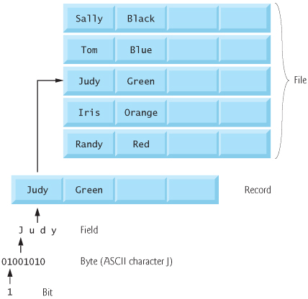
Figure 1.3 Data Hierarchy

Slide 28
1.4 Data Hierarchy (2 of 8)
Bits
The smallest data item in a computer can assume the value 0 or the value 1.
Called a bit (short for “binary digit”—a digit that can assume one of two values)

Slide 29
1.4 Data Hierarchy (3 of 8)
Characters
Tedious to work with data in the low-level form of bits.
People prefer to work with decimal digits (0–9), letters (A–Z and a–z), and special symbols (e.g., $, @, %, &, *, (, ), –, +, ", :, ? and /)
Known as characters.
The computer’s character set is the set of all the characters used to write programs and represent data items.
Computers process only 1s and 0s, so a computer’s character set represents every character as a pattern of 1s and 0s.

Slide 30
1.4 Data Hierarchy (4 of 8)
Fields
Just as characters are composed of bits, fields are composed of characters or bytes.
A field is a group of characters or bytes that conveys meaning.
A field consisting of uppercase and lowercase letters can be used to represent a person’s name
A field consisting of decimal digits could represent a person’s age.

Slide 31
1.4 Data Hierarchy (5 of 8)
Records
Several related fields can be used to compose a record.
In a payroll system, for example, the record for an employee might consist of the following fields
Employee identification number (a whole number)
Name (a string of characters)
Address (a string of characters)
Hourly pay rate (a number with a decimal point)
Year-to-date earnings (a number with a decimal point)
Amount of taxes withheld (a number with a decimal point).
A company might have many employees and a payroll record for each.

Slide 32
1.4 Data Hierarchy (6 of 8)
Files
A file is a group of related records.
[Note: More generally, a file contains arbitrary data in arbitrary formats. In some operating systems, a file is viewed simply as a sequence of bytes—any organization of the bytes in a file, such as organizing the data into records, is a view created by the application programmer.]
It’s not unusual for an organization to have many files, some containing billions, or even trillions, of characters of information.

Slide 33
1.4 Data Hierarchy (7 of 8)
Database
A database is a collection of data organized for easy access and manipulation.
The most popular model is the relational database
Data is stored in simple tables.
A table includes records and fields.
You can search, sort and otherwise manipulate the data based on its relationship to multiple tables or databases.

Slide 34
1.4 Data Hierarchy (8 of 8)
Big Data
The amount of data being produced worldwide is enormous and growing quickly.
According to I B M, approximately 2.5 quintillion bytes (2.5 exabytes) of data are created daily
According to Salesforce.com, 90% of the world’s data was created in just the past 12 months!
According to an I D C study, the global data supply will reach 40 zettabytes (equal to 40 trillion gigabytes) annually by 2020.
Figure 1.4 shows some common byte measurements.
Big data applications deal with massive amounts of data.

Slide 35
Figure 1.4 Byte Measurements
Unit | Bytes | Which is approximately
1 kilobyte (K B) | 1024 bytes | 10 cube (1024) bytes exactly
1 megabyte (M B) | 1024 kilobytes | 10 to the sixth power (1,000,000 )bytes
1 gigabyte (G B) | 1024 megabytes | 10 to the ninth power (1,000,000,000) bytes
1 terabyte (T B) | 1024 gigabytes | 10 to the twelfth power (1,000,000,000,000) bytes
1 petabyte (P B) | 1024 terabytes | 10 to the fifteenth power (1,000,000,000,000,000) bytes
1 exabyte (E B) | 1024 petabytes | 10 to the eighteenth power (1,000,000,000,000,000,000) bytes
1 zettabyte (Z B) | 1024 exabytes | 10 to the twenty one power (1,000,000,000,000,000,000,000) bytes

Slide 36
1.5 Machine Languages, Assembly Languages and High-Level Languages (1 of 5)
Programmers write instructions in various programming languages, some directly understandable by computers and others requiring intermediate translation steps.
These may be divided into three general types:
Machine languages
Assembly languages
High-level languages

Slide 37
1.5 Machine Languages, Assembly Languages and High-Level Languages (2 of 5)
Machine Languages
Any computer can directly understand only its own machine language (also called machine code), defined by its hardware architecture.
Machine languages generally consist of numbers (ultimately reduced to 1s and 0s). Such languages are cumbersome for humans.

Slide 38
1.5 Machine Languages, Assembly Languages and High-Level Languages (3 of 5)
Assembly Languages
English-like abbreviations to represent elementary operations. These abbreviations formed the basis of assembly languages.
Translator programs called assemblers were developed to convert early assembly-language programs to machine language.

Slide 39
1.5 Machine Languages, Assembly Languages and High-Level Languages (4 of 5)
High-Level Languages
To speed up the programming process further, high-level languages were developed in which single statements could be written to accomplish substantial tasks.
Translator programs called compilers convert high-level language programs into machine language.
Allow you to write instructions that look more like everyday English and contain commonly used mathematical expressions.

Slide 40
1.5 Machine Languages, Assembly Languages and High-Level Languages (5 of 5)
Compiling a high-level language program into machine language can take a considerable amount of computer time.
Interpreter programs were developed to execute high-level language programs directly (without the need for compilation), although more slowly than compiled programs.
Scripting languages such as the popular web languages Java Script and P H P are processed by interpreters.

Slide 41
Performance Tip 1.1
Interpreters have an advantage over compilers in Internet scripting. An interpreted program can begin executing as soon as it’s downloaded to the client’s machine, without needing to be compiled before it can execute. On the downside, interpreted scripts generally run slower and consume more memory than compiled code.

Slide 42
1.6 C and C++ (1 of 4)
C was implemented in 1972 by Dennis Ritchie at Bell Laboratories.
Initially became widely known as the U N I X operating system’s development language.
Today, most of the code for general-purpose operating systems is written in C or C++.
C++ evolved from C, which is available for most computers and is hardware independent.

Slide 43
1.6 C and C++ (2 of 4)
The widespread use of C with various kinds of computers (sometimes called hardware platforms) led to many variations.
American National Standards Institute (A N S I) cooperated with the International Organization for Standardization (I S O) to standardize C worldwide.
Joint standard document was published in 1990.

Slide 44
1.6 C and C++ (3 of 4)
C11
Latest A N S I standard for the language.
Developed to evolve the C language to keep pace with increasingly powerful hardware and ever more demanding user requirements.
Makes C more consistent with C++.
C++, an extension of C, was developed by Bjarne Strou strup in 1979 at Bell Laboratories.
C++ provides a number of features that “spruce up” the C language.
C++ also provides capabilities for object-oriented programming that were inspired by the Simula simulation programming language.

Slide 45
1.6 C and C++ (4 of 4)
C++ Standard Library
C++ programs consist of pieces called classes and functions.
Most C++ programmers take advantage of the rich collections of classes and functions in the C++ Standard Library.
Two parts to learning the C++ “world.”
The C++ language itself (the core language), and
How to use the classes and functions in the C++ Standard Library.
Many special-purpose class libraries are supplied by independent software vendors.

Slide 46
Software Engineering Observation 1.1
Use a “building-block” approach to create programs. Avoid reinventing the wheel. Use existing pieces wherever possible. Called software reuse, this practice is central to effective object-oriented programming.

Slide 47
Software Engineering Observation 1.2
When programming in C++, you typically will use the following building blocks: classes and functions from the C++ Standard Library, classes and functions you and your colleagues create, and classes and functions from various popular third-party libraries.

Slide 48
Performance Tip 1.2
Using C++ Standard Library functions and classes instead of writing your own versions can improve program performance, because they’re written carefully to perform efficiently. This technique also shortens program development time.

Slide 49
Portability Tip 1.1
Using C++ Standard Library functions and classes instead of writing your own improves program portability, because they’re included in every C++ implementation.

Slide 50
1.7 Programming Languages
In this section, we provide brief comments on several popular programming languages (Figure 1.5).

Slide 51
Figure 1.5 Some Other Programming Languages (1 of 6)
Programming language | Description
Fortran | Fortran (FORmula TRANslator) was developed by I B M Corporation in the mid-1950s to be used for scientific and engineering applications that require complex mathematical computations. It’s still widely used and its latest versions support object-oriented programming.
C O B O L | C O B O L (COmmon Business Oriented Language) was developed in the late 1950s by computer manufacturers, the U.S. government and industrial computer users, based on a language developed by Grace Hopper, a career U.S. Navy officer and computer scientist. C O B O L is still widely used for commercial applications that require precise and efficient manipulation of large amounts of data. Its latest version supports object-oriented programming.

Slide 52
Figure 1.5 Some Other Programming Languages (2 of 6)
Programming language | Description
Pascal | Research in the 1960s resulted in structured programming—a disciplined approach to writing programs that are clearer, easier to test and debug and easier to modify than programs produced with previous techniques. The Pascal language developed by Professor Niklaus Wirth in 1971 grew out of this research. It was popular for teaching structured programming for several decades.
Ada | Ada, based on Pascal, was developed under the sponsorship of the U.S. Department of Defense (D O D) during the 1970s and early 1980s. The D O D wanted a single language that would fill most of its needs. The Pascal-based language was named after Lady Ada Lovelace, daughter of the poet Lord Byron. She’s credited with writing the world’s first computer program in the early 1800s (for the Analytical Engine mechanical computing device designed by Charles Babbage). Ada also supports object-oriented programming.

Slide 53
Figure 1.5 Some Other Programming Languages (3 of 6)
Programming language | Description
Basic | Basic was developed in the 1960s at Dartmouth College to familiarize novices with programming techniques. Many of its latest versions are object oriented.
Objective-C | Objective-C is an object-oriented language based on C. It was developed in the early 1980s and later acquired by NeXT, which in turn was acquired by Apple. It became the key programming language for the O S X operating system and all i O S-powered devices (such as iPods, iPhones and iPads).
Swift | Swift, which was introduced in 2014, is Apple’s programming language of the future for developing i O S and O S X applications (apps). Swift is a contemporary language that includes popular programming-language features from languages such as Objective-C, Java, C#, Ruby, Python and others. In 2015, Apple released Swift 2 with new and updated features. According to the Tiobe Index, Swift has already become one of the most popular programming languages. Swift is now open source (Section 1.11.2), so it can be used on non-Apple platforms as well.

Slide 54
Figure 1.5 Some Other Programming Languages (4 of 6)
Programming language | Description
Java | Sun Microsystems in 1991 funded an internal corporate research project led by James Gosling, which resulted in the C++-based object-oriented programming language called Java. A key goal of Java is to enable developers to write programs that will run on a great variety of computer systems and computer-controlled devices. This is sometimes called “write once, run anywhere.” Java is used to develop large-scale enterprise applications, to enhance the functionality of web servers (the computers that provide the content we see in our web browsers), to provide applications for consumer devices (e.g., smartphones, tablets, television set-top boxes, appliances, automobiles and more) and for many other purposes. Java is also the key language for developing Android smartphone and tablet apps.
Visual Basic | Microsoft’s Visual Basic language was introduced in the early 1990s to simplify the development of Microsoft Windows applications. Its latest versions support object-oriented programming.
C# | Microsoft’s three primary object-oriented programming languages are C# (based on C++ and Java), Visual C++ (based on C++) and Visual Basic (based on the original Basic). C# was developed to integrate the web into computer applications, and is now widely used to develop enterprise applications and for mobile application development.

Slide 55
Figure 1.5 Some Other Programming Languages (5 of 6)
Programming language | Description
P H P | P H P is an object-oriented, open-source (see Section 1.11.2) “scripting” language supported by a community of developers and used by numerous websites. P H P is platform independent—implementations exist for all major UNIX, Linux, Mac and Windows operating systems.
Python | Python, another object-oriented scripting language, was released publicly in 1991. Developed by Guido van Rossum of the National Research Institute for Mathematics and Computer Science in Amsterdam (C W I), Python draws heavily from Modula-3—a systems programming language. Python is “extensible”—it can be extended through classes and programming interfaces.
JavaScript | JavaScript is the most widely used scripting language. It’s primarily used to add programmability to web pages—for example, animations and interactivity with the user. It’s provided with all major web browsers.

Slide 56
Figure 1.5 Some Other Programming Languages (6 of 6)
Programming language | Description
Ruby on Rails | Ruby—created in the mid-1990s by Yukihiro Matsumoto—is an open-source, object-oriented programming language with a simple syntax that’s similar to Python. Ruby on Rails combines the scripting language Ruby with the Rails web application framework developed by the company 37Signals. Their book, Getting Real (http://gettingreal.37signals.com/toc.php), is a must read for web developers. Many Ruby on Rails developers have reported productivity gains over other languages when developing database-intensive web applications.
Scala | Scala (www.scala-lang.org/node/273)—short for “scalable language”—was designed by Martin Odersky, a professor at École Polytechnique Fédérale de Lausanne (E P F L) in Switzerland. Released in 2003, Scala uses both the object-oriented programming and functional programming paradigms and is designed to integrate with Java. Programming in Scala can reduce the amount of code in your applications significantly.

Slide 57
1.8 Introduction to Object Technology (1 of 16)
Objects, or more precisely—as we’ll see in Chapter 3—the classes objects come from, are essentially reusable software components.
There are date objects, time objects, audio objects, video objects, automobile objects, people objects, etc.
Almost any noun can be reasonably represented as a software object in terms of attributes (e.g., name, color and size) and behaviors (e.g., calculating, moving and communicating).
Using a modular, object-oriented design-and-implementation approach can make software-development groups much more productive than was possible with earlier techniques—object-oriented programs are often easier to understand, correct and modify.

Slide 58
1.8 Introduction to Object Technology (2 of 16)
The Automobile as an Object
Let’s begin with a simple analogy.
Suppose you want to drive a car and make it go faster by pressing its accelerator pedal.
Before you can drive a car, someone has to design it.
A car typically begins as engineering drawings, similar to the blueprints that describe the design of a house.
Drawings include the design for an accelerator pedal.
Pedal hides from the driver the complex mechanisms that actually make the car go faster, just as the brake pedal hides the mechanisms that slow the car, and the steering wheel hides the mechanisms that turn the car.

Slide 59
1.8 Introduction to Object Technology (3 of 16)
Enables people with little or no knowledge of how engines, braking and steering mechanisms work to drive a car easily.
Before you can drive a car, it must be built from the engineering drawings that describe it.
A completed car has an actual accelerator pedal to make the car go faster, but even that’s not enough—the car won’t accelerate on its own (hopefully!), so the driver must press the pedal to accelerate the car.

Slide 60
1.8 Introduction to Object Technology (4 of 16)
Functions, Member Functions and Classes
Performing a task in a program requires a member function
Houses the program statements that actually perform its task.
Hides these statements from its user, just as the accelerator pedal of a car hides from the driver the mechanisms of making the car go faster.

Slide 61
1.8 Introduction to Object Technology (5 of 16)
In C++, we create a program unit called a class to house the set of functions that perform the class’s tasks—these are the class’s member functions.
A class is similar in concept to a car’s engineering drawings, which house the design of an accelerator pedal, steering wheel, and so on.

Slide 62
1.8 Introduction to Object Technology (6 of 16)
Instantiation
Just as someone has to build a car from its engineering drawings before you can actually drive a car, you must build an object from a class before a program can perform the tasks that the class’s member functions define.
An object is then referred to as an instance of its class.

Slide 63
1.8 Introduction to Object Technology (7 of 16)
Reuse
Just as a car’s engineering drawings can be reused many times to build many cars, you can reuse a class many times to build many objects.
Reuse of existing classes when building new classes and programs saves time and effort.

Slide 64
1.8 Introduction to Object Technology (8 of 16)
Reuse also helps you build more reliable and effective systems, because existing classes and components often have gone through extensive testing, debugging and performance tuning.
Just as the notion of interchangeable parts was crucial to the Industrial Revolution, reusable classes are crucial to the software revolution that has been spurred by object technology.

Slide 65
1.8 Introduction to Object Technology (9 of 16)
Messages and Member-Function Calls
When you drive a car, pressing its gas pedal sends a message to the car to perform a task—that is, to go faster.
Similarly, you send messages to an object.
Each message is implemented as a member-function call that tells a member function of the object to perform its task.

Slide 66
1.8 Introduction to Object Technology (10 of 16)
Attributes and Data Members
A car has attributes
Color, its number of doors, the amount of gas in its tank, its current speed and its record of total miles driven (i.e., its odometer reading).
The car’s attributes are represented as part of its design in its engineering diagrams.
Every car maintains its own attributes.
Each car knows how much gas is in its own gas tank, but not how much is in the tanks of other cars.

Slide 67
1.8 Introduction to Object Technology (11 of 16)
An object has attributes that it carries along as it’s used in a program.
Specified as part of the object’s class.
A bank account object has a balance attribute that represents the amount of money in the account.
Each bank account object knows the balance in the account it represents, but not the balances of the other accounts in the bank.
Attributes are specified by the class’s data members.

Slide 68
1.8 Introduction to Object Technology (12 of 16)
Encapsulation
Classes encapsulate (i.e., wrap) attributes and member functions into objects created from those classes
An object’s attributes and member functions are intimately related.
Objects may communicate with one another
They’re normally not allowed to know how other objects are implemented—implementation details are hidden.
Information hiding is crucial to good software engineering.

Slide 69
1.8 Introduction to Object Technology (13 of 16)
Inheritance
A new class of objects can be created quickly and conveniently by inheritance—the new class absorbs the characteristics of an existing class, possibly customizing them and adding unique characteristics of its own.
In our car analogy, an object of class “convertible” certainly is an object of the more general class “automobile,” but more specifically, the roof can be raised or lowered.

Slide 70
1.8 Introduction to Object Technology (14 of 16)
Object-Oriented Analysis and Design (O O A D)
How will you create the code (i.e., the program instructions) for your programs?
Follow a detailed analysis process for determining your project’s requirements (i.e., defining what the system is supposed to do)
Develop a design that satisfies them (i.e., deciding how the system should do it).
Carefully review the design (and have your design reviewed by other software professionals) before writing any code.

Slide 71
1.8 Introduction to Object Technology (15 of 16)
If this process involves analyzing and designing your system from an object-oriented point of view, it’s called an object-oriented analysis and design (O O A D) process.
Languages like C++ are object oriented.
Object-oriented programming (O O P) allows you to implement an object-oriented design as a working system.

Slide 72
1.8 Introduction to Object Technology (16 of 16)
The U M L (Unified Modeling Language)
The Unified Modeling Language (U M L) is now the most widely used graphical scheme for modeling object-oriented systems.

Slide 73
1.9 Typical C++ Development Environment (1 of 12)
C++ systems generally consist of three parts: a program development environment, the language and the C++ Standard Library.
C++ programs typically go through six phases: edit, preprocess, compile, link, load and execute.

Slide 74
1.9 Typical C++ Development Environment (2 of 12)
Phase 1 consists of editing a file with an editor program, normally known simply as an editor.
Type a C++ program (source code) using the editor.
Make any necessary corrections.
Save the program.
C++ source code filenames often end with the .cpp, .cxx, .cc or .C extensions, which indicate that a file contains C++ source code.

Slide 75

Figure 1.6 Typical C++ Development Environment—Editing Phase

Slide 76
1.9 Typical C++ Development Environment (3 of 12)
Linux editors: vi and e macs.
You can also use a simple text editor, such as Notepad in Windows, to write your C++ code.
integrated development environments (I D E s)
Provide tools that support the software-development process, including editors for writing and editing programs and debuggers for locating logic errors—errors that cause programs to execute incorrectly.

Slide 77
1.9 Typical C++ Development Environment (4 of 12)
Popular I D E s
Microsoft® Visual Studio 2015 Community Edition
Net Beans
Eclipse
Apple’s Xcode
CodeLite
Clion

Slide 78
1.9 Typical C++ Development Environment (5 of 12)
In phase 2, you give the command to compile the program.
A preprocessor program executes automatically before the compiler’s translation phase begins (so we call preprocessing Phase 2 and compiling Phase 3).
The C++ preprocessor obeys commands called preprocessing directives, which indicate that certain manipulations are to be performed on the program before compilation.
These manipulations usually include (copy into the program file) other text files to be compiled, and perform various text replacements.

Slide 79

Figure 1.7 Typical C++ Development Environment—Preprocessor Phase

Slide 80
1.9 Typical C++ Development Environment (6 of 12)
In Phase 3, the compiler translates the C++ program into machine-language code—also referred to as object code.

Slide 81

Figure 1.8 Typical C++ Development Environment—Compilation Phase

Slide 82
1.9 Typical C++ Development Environment (7 of 12)
Phase 4 is called linking.
The object code produced by the C++ compiler typically contains “holes” due to these missing parts.
A linker links the object code with the code for the missing functions to produce an executable program.
If the program compiles and links correctly, an executable image is produced.

Slide 83
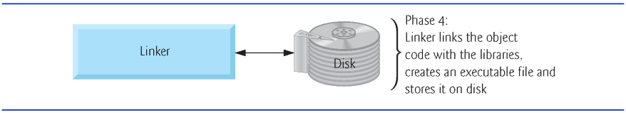
Figure 1.9 Typical C++ Development Environment—Linking Phase

Slide 84
1.9 Typical C++ Development Environment (8 of 12)
Phase 5 is called loading.
Before a program can be executed, it must first be placed in memory. T
his is done by the loader, which takes the executable image from disk and transfers it to memory.
Additional components from shared libraries that support the program are also loaded.

Slide 85
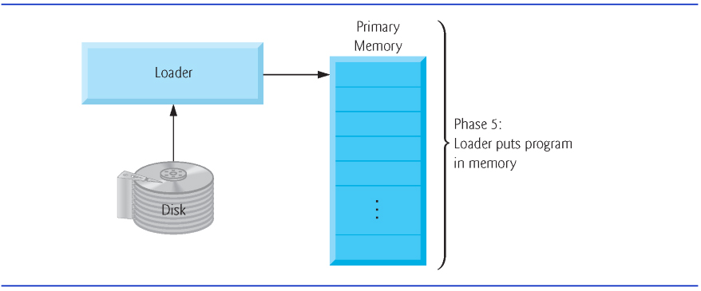
Figure 1.10 Typical C++ Development Environment—Loading Phase

Slide 86
1.9 Typical C++ Development Environment (9 of 12)
Phase 6: Execution
Finally, the computer, under the control of its C P U, executes the program one instruction at a time.
Some modern computer architectures often execute several instructions in parallel.

Slide 87
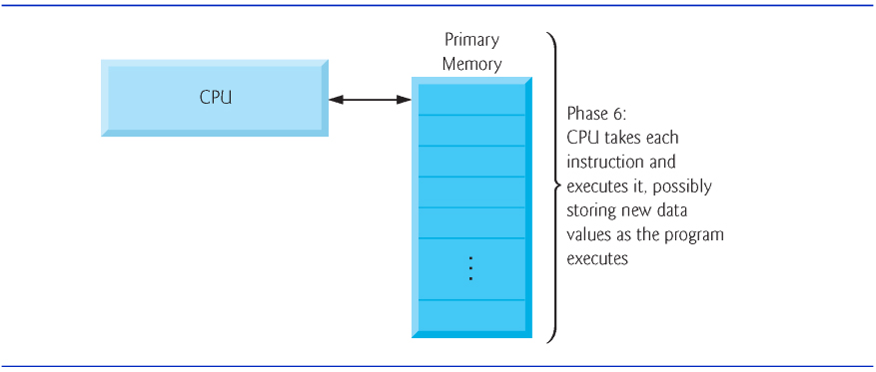
Figure 1.11 Typical C++ Development Environment—Execution Phase

Slide 88
1.9 Typical C++ Development Environment (10 of 12)
Problems That May Occur at Execution Time
Programs might not work on the first try.
Each of the preceding phases can fail because of various errors that we’ll discuss throughout this book.
If this occurred, you’d have to return to the edit phase, make the necessary corrections and proceed through the remaining phases again to determine that the corrections fixed the problem(s).
Most programs in C++ input or output data.

Slide 89
1.9 Typical C++ Development Environment (11 of 12)
Certain C++ functions take their input from c in (the standard input stream; pronounced “see-in”), which is normally the keyboard, but c in can be redirected to another device.
Data is often output to c out (the standard output stream; pronounced “see-out”), which is normally the computer screen, but c out can be redirected to another device.
When we say that a program prints a result, we normally mean that the result is displayed on a screen.

Slide 90
1.9 Typical C++ Development Environment (12 of 12)
Data may be output to other devices, such as disks, hardcopy printers or even transmitted over the Internet.
There is also a standard error stream referred to as cerr. The cerr stream is used for displaying error messages.

Slide 91
Common Programming Error 1.1
Errors such as division by zero occur as a program runs, so they’re called runtime errors or execution-time errors. Fatal runtime errors cause programs to terminate immediately without having successfully performed their jobs. Nonfatal runtime errors allow programs to run to completion, often producing incorrect results.

Slide 92
1.10 Test-Driving a C++ Application (1 of 2)
In this section, you’ll compile, run and interact with your first C++ application.
Guess-the-number game, which picks a number from 1 to 1000 and prompts you to guess it.
If your guess is correct, the game ends.
If your guess is not correct, the application indicates whether your guess is higher or lower than the correct number. There is no limit on the number of guesses you can make.

Slide 93
1.10 Test-Driving a C++ Application (2 of 2)
[Note: For this test drive only, we’ve modified this application from the exercise you’ll be asked to create in Chapter 6, Functions and an Introduction to Recursion. Normally this application randomly selects the correct answer as you execute the program. The modified application uses the same correct answer every time the program executes (though this may vary by compiler), so you can use the same guesses we use in this section and see the same results as we walk you through interacting with your first C++ application.]

Slide 94
1.10.1 Compiling and Running an Application in Visual Studio 2015 for Windows (1 of 13)
In this section, you’ll run a C++ program on Windows using Microsoft Visual Studio 2015 Community Edition.
There are several versions of Visual Studio available—on some versions, the options, menus and instructions we present might differ slightly. From this point forward, we’ll refer to Visual Studio 2015 Community Edition simply as “Visual Studio” or “the I D E.”

Slide 95
1.10.1 Compiling and Running an Application in Visual Studio 2015 for Windows (2 of 13)
Step 1: Checking Your Setup
It’s important to read this book’s Before You Begin section to make sure that you’ve installed Visual Studio and copied the book’s examples to your hard drive correctly.

Slide 96
1.10.1 Compiling and Running an Application in Visual Studio 2015 for Windows (3 of 13)
Step 2: Launching Visual Studio
Open Visual Studio from the Start menu.
The I D E displays the Start Page (Figure 1.12), which provides links for creating new programs, opening existing programs and learning about the I D E and various programming topics.
Close this window for now by clicking the X in its tab—you can access this window any time by selecting View > Start Page.
We use the > character to indicate selecting a menu item from a menu. For example, the notation File > Open indicates that you should select the Open menu item from the File menu.

Slide 97
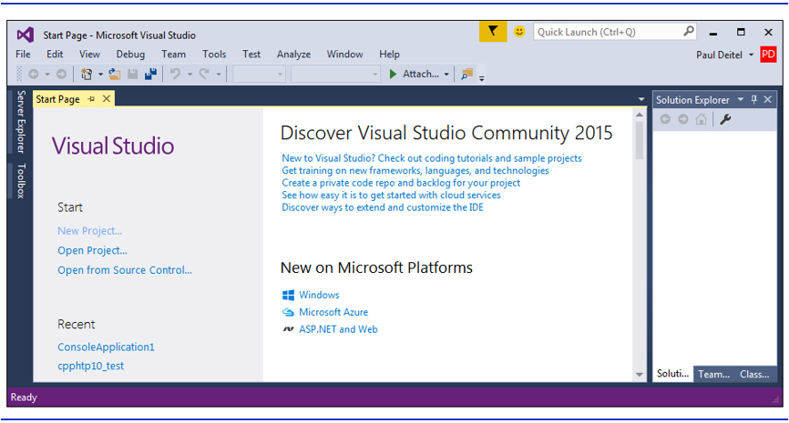
Figure 1.12 Visual Studio 2015 Community Edition Window Showing the Start Page

Slide 98
1.10.1 Compiling and Running an Application in Visual Studio 2015 for Windows (4 of 13)
Step 3: Creating a Project
A project is a group of related files, such as the C++ source-code files that compose an application.
Visual Studio organizes applications into projects and solutions, which contain one or more projects.
Multiple-project solutions are used to create large-scale applications.
Each application in this book will be a solution containing a single project.

Slide 99
1.10.1 Compiling and Running an Application in Visual Studio 2015 for Windows (5 of 13)
This book’s examples are Win32 Console Application projects that you’ll execute from the I D E.
Select File > New > Project….
At the New Project dialog’s left side, select the category Installed > Templates > Visual C++ > Win32 (Figure 1.13).

Slide 100
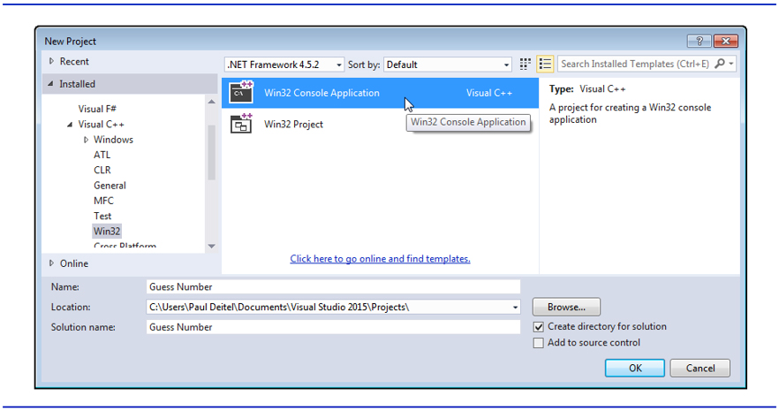
Figure 1.13 Visual Studio 2015 Community Edition New Project Dialog

Slide 101
1.10.1 Compiling and Running an Application in Visual Studio 2015 for Windows (6 of 13)
Step 3: Creating a Project
In the New Project dialog’s middle section, select Win32 Console Application.
Provide a name for your project in the Name field—we specified Guess Number—then click OK to display the Win32 Application Wizard window, then click Next > to display the Application Settings step.
Configure the settings as shown in Figure 1.14 to create a solution containing an empty project, then click Finish.

Slide 102
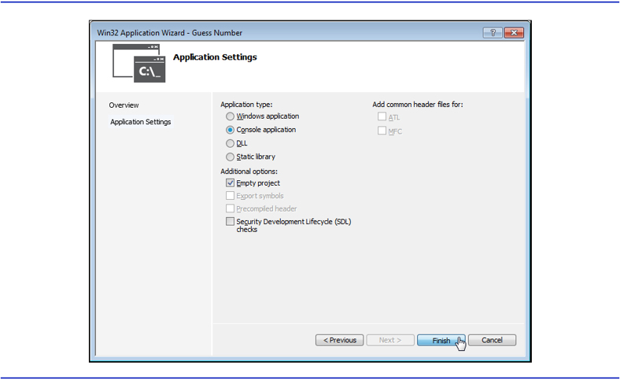
Figure 1.14 Win32 Application Wizard Window’s Application Settings Step

Slide 103
1.10.1 Compiling and Running an Application in Visual Studio 2015 for Windows (7 of 13)
Step 3: Creating a Project
At this point, the I D E opens the window in Figure 1.15 and creates your project and places its folder in
C:\Users\YourUserAccount\Documents\Visual Studio 2015\Projects
This window displays editors as tabbed windows (one for each file) when you’re editing code.
Also displayed is the Solution Explorer in which you can view and manage your application’s files. You’ll typically place each program’s code files in the Source Files folder.
If the Solution Explorer is not displayed, you can display it by selecting View > Solution Explorer.

Slide 104
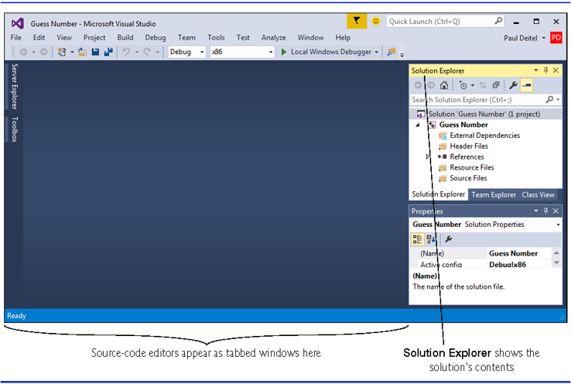
Figure 1.15 Visual Studio Window After Creating the Guess Number Project

Slide 105
1.10.1 Compiling and Running an Application in Visual Studio 2015 for Windows (8 of 13)
Step 4: Adding the Guess Number.cpp File into the Project
Next, add Guess Number.cpp to the project you created in Step 3.
In Windows Explorer (Windows 7) or File Explorer (Windows 8 and 10), open the ch01 folder in the book’s examples folder, then drag Guess Number.cpp onto the Source Files folder in the Solution Explorer.

Slide 106
1.10.1 Compiling and Running an Application in Visual Studio 2015 for Windows (9 of 13)
Step 5: Compiling and Running the Project
To compile and run the project so you can test-drive the application, select Debug > Start without debugging or simply type Ctrl + F5.
If the program compiles correctly, the I D E opens a Command Prompt window and executes the program (Figure 1.16)
We changed the Command Prompt’s color scheme to make the screen captures more readable.
The application displays "Please type your first guess.", then displays a question mark (?) as a prompt on the next line.

Slide 107
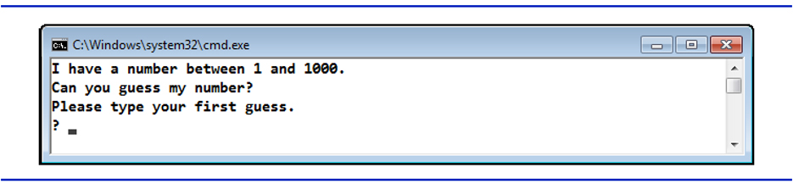
Figure 1.16 Command Prompt Showing the Running Program

Slide 108
1.10.1 Compiling and Running an Application in Visual Studio 2015 for Windows (10 of 13)
Step 6: Entering Your First Guess
Type 500 and press Enter.
The application displays “Too high. Try again.” (Figure 1.17), meaning that the value you entered is greater than the number the application chose as the correct guess.

Slide 109
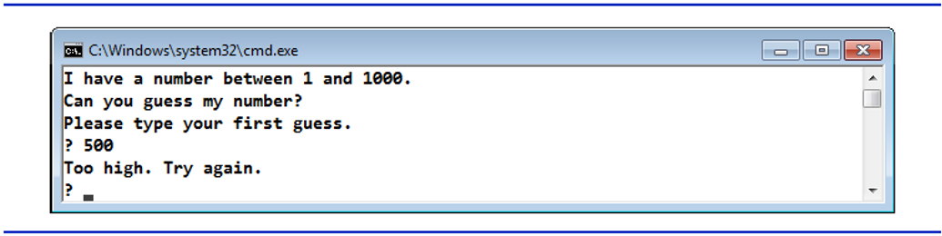
Figure 1.17 Entering an Initial Guess and Receiving Feedback

Slide 110
1.10.1 Compiling and Running an Application in Visual Studio 2015 for Windows (11 of 13)
Step 7: Entering Another Guess
At the next prompt, enter 250 (Figure 1.18).
The application displays “Too high. Try again.”, because the value you entered once again is greater than the correct guess.

Slide 111
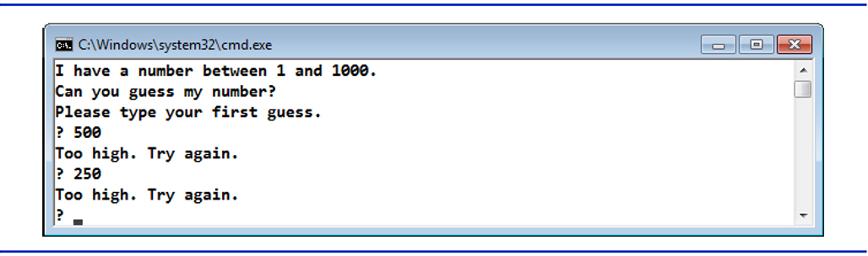
Figure 1.18 Entering a Second Guess and Receiving Feedback

Slide 112
1.10.1 Compiling and Running an Application in Visual Studio 2015 for Windows (12 of 13)
Step 8: Entering Additional Guesses
Continue to play the game (Figure 1.19) by entering values until you guess the correct number.
When you guess correctly, the application displays “Excellent! You guessed the number.”

Slide 113
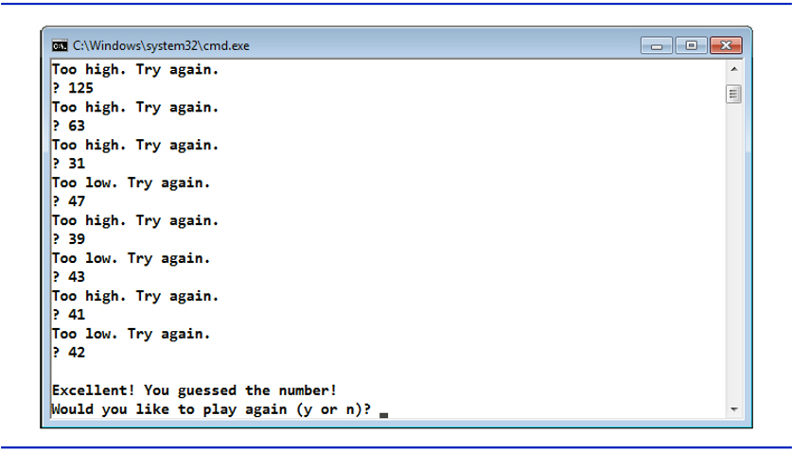
Figure 1.19 | Entering Additional Guesses and Guessing the Correct Number

Slide 114
1.10.1 Compiling and Running an Application in Visual Studio 2015 for Windows (13 of 13)
Step 9: Playing the Game Again or Exiting the Application
After you guess the correct number, the application asks if you’d like to play another game.
At the “Would you like to play again (y or n)?” prompt, entering the one character y causes the application to choose a new number and displays the message “Please type your first guess.” followed by a question-mark prompt so you can make your first guess in the new game.
Entering the character n terminates the application.
Each time you execute this application from the beginning (Step 5), it will choose the same numbers for you to guess.

Slide 115
1.10.2 Compiling and Running Using G N U C++ on Linux (1 of 8)
For this test drive, we assume that you read the Before You Begin section and that you placed the downloaded examples in your home directory on your Linux system.
The prompt in the shell on our system uses the tilde (~) character to represent the home directory, and each prompt ends with the dollar sign ($) character. The prompt will vary among Linux systems.

Slide 116
1.10.2 Compiling and Running Using G N U C++ on Linux (2 of 8)
Step 1: Locating the Completed Application
From a Linux shell, use the command cd to change to the completed application directory (Figure 1.20) by typing
cd examples/chapter01
then pressing Enter.

Slide 117
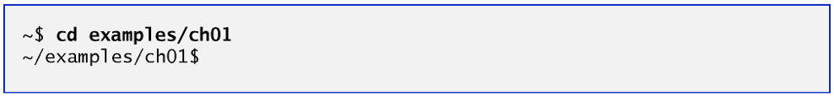
Figure 1.20 Changing to the Guess Number Application’s Directory

Slide 118
1.10.2 Compiling and Running Using G N U C++ on Linux (3 of 8)
Step 2: Compiling the Application
Before running the application, you must first compile it (Figure 1.21) by typing
g++ -std=c++14 Guess Number.cpp -o Guess Number
This command compiles the application for C++14 (the current C++ version) and produces an executable file called Guess Number.

Slide 119
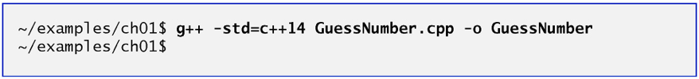
Figure 1.21 Compiling the Guess Number Application Using the G++ Command

Slide 120
1.10.2 Compiling and Running Using G N U C++ on Linux (4 of 8)
Step 3: Running the Application
To run the executable file Guess Number, type ./Guess Number at the next prompt, then press Enter (Figure 1.22).
The ./ tells Linux to run from the current directory and is required to indicate that Guess Number is an executable file.

Slide 121
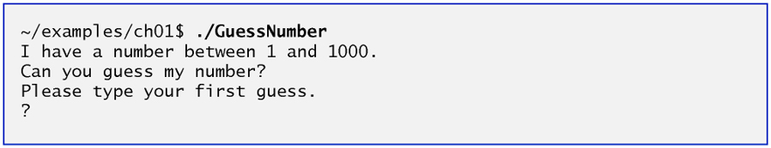
Figure 1.22 Running the GuessNumber Application

Slide 122
1.10.2 Compiling and Running Using G N U C++ on Linux (5 of 8)
Step 4: Entering Your First Guess
The application displays “Please type your first guess.”, then displays a question mark (?) as a prompt on the next line (Figure 1.22).
At the prompt, enter 500 (Figure 1.23). [Note that the outputs may vary based on the compiler you’re using.]

Slide 123
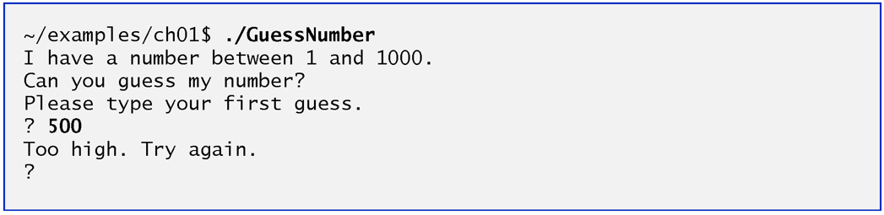
Figure 1.23 Entering an Initial Guess

Slide 124
1.10.2 Compiling and Running Using G N U C++ on Linux (6 of 8)
Step 5: Entering Another Guess
The application displays “Too high. Try again.”, meaning that the value you entered is greater than the number the application chose as the correct guess (Figure 1.23).
At the next prompt, enter 250 (Figure 1.24).
This time the application displays “Too low. Try again.”, because the value you entered is less than the correct guess.

Slide 125
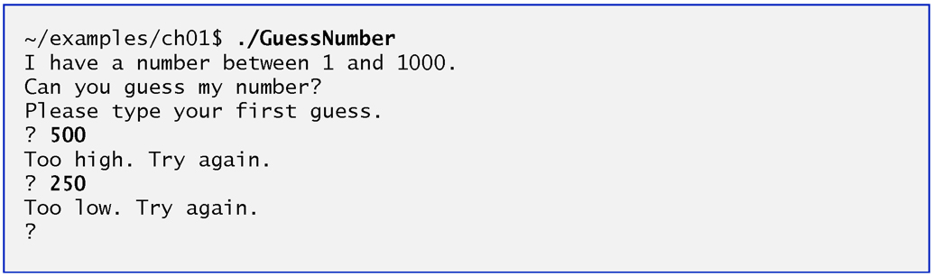
Figure 1.24 Entering a Second Guess and Receiving Feedback

Slide 126
1.10.2 Compiling and Running Using G N U C++ on Linux (7 of 8)
Step 6: Entering Additional Guesses
Continue to play the game (Figure 1.25) by entering values until you guess the correct number.
When you guess correctly, the application displays “Excellent! You guessed the number.”

Slide 127
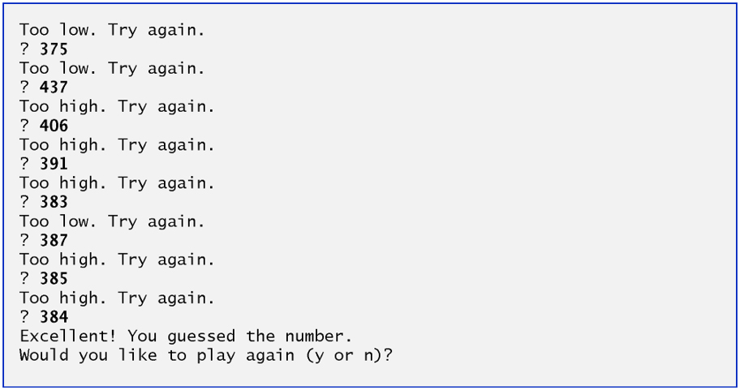
Figure 1.25 Entering Additional Guesses and Guessing the Correct Number

Slide 128
1.10.2 Compiling and Running Using G N U C++ on Linux (8 of 8)
Step 7: Playing the Game Again or Exiting the Application
After you guess the correct number, the application asks if you’d like to play another game.
At the “Would you like to play again (y or n)?” prompt, entering the one character y causes the application to choose a new number and displays the message “Please type your first guess.” followed by a question-mark prompt so you can make your first guess in the new game.
Entering the character n ends the application, returns you to the shell and awaits your next command.

Slide 129
1.10.3 Compiling and Running with Xcode on Mac O S X (1 of 15)
Step 1: Checking Your Setup
It’s important to read this book’s Before You Begin section to make sure that you’ve installed Apple’s X code I D E and copied the book’s examples to your hard drive correctly.

Slide 130
1.10.3 Compiling and Running with Xcode on Mac O S X (2 of 15)
Step 2: Launching X code
Open a Finder window, select Applications and double click the X code icon.
If this is your first time running Xcode, the Welcome to X code window will appear (Figure 1.26).
Close this window for now—you can access it any time by selecting Window > Welcome to X code.

Slide 131
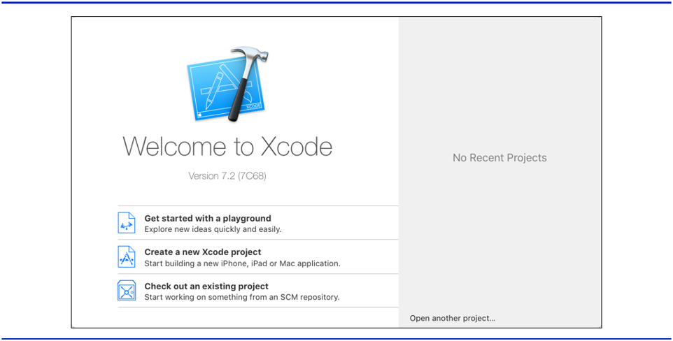
Figure 1.26 Welcome to X code Window

Slide 132
1.10.3 Compiling and Running with X code on Mac O S X (3 of 15)
Step 3: Creating a Project
A project is a group of related files, such as the C++ source-code files that compose an application.
The X code projects we created for this book’s examples are O S X Command Line Tool projects that you’ll execute directly in the I D E. To create a project:

Slide 133
1.10.3 Compiling and Running with X code on Mac O S X (4 of 15)
Select File > New > Project….
In the O S X subcategory Application, select Command Line Tool and click Next.
Provide a name for your project in the Product Name field—we specified Guess Number.
Ensure that the selected Language is C++ and click Next.
Specify where you want to store your project, then click Create. (See the Before You Begin section for information on configuring a project to use C++14.)

Slide 134
1.10.3 Compiling and Running with X code on Mac O S X (5 of 15)
Figure 1.27 shows the workspace window that appears after you create the project.
By default, X code creates a main.cpp source-code file containing a simple program that displays “Hello, World!’.
The window is divided into four main areas below the toolbar: the Navigator area, Editor area and Utilities area are displayed initially. We’ll explain momentarily how to display the Debug area in which you’ll run and interact with the program.

Slide 135
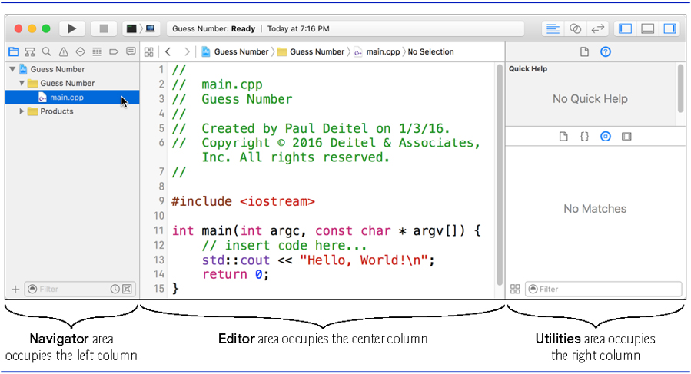
Figure 1.27 Sample Xcode C++ Project with main.cpp Selected

Slide 136
1.10.3 Compiling and Running with X code on Mac O S X (6 of 15)
At the left of the workspace window is the Navigator area.
The Project navigator shows all the files and folders in your project.
The Issue navigator shows you warnings and errors generated by the compiler.
You choose which navigator to display by clicking the corresponding button above the Navigator area of the window.

Slide 137
1.10.3 Compiling and Running with X code on Mac O S X (7 of 15)
To the right of the Navigator area is the Editor area for editing source code.
When you select a file in the Project navigator, the file’s contents are displayed in the Editor area.
At the right side of the workspace window is the Utilities area, which you will not use in this book.
The Debug area, when displayed, appears below the Editor area.

Slide 138
1.10.3 Compiling and Running with X code on Mac O S X (8 of 15)
The toolbar contains options for executing a program (Figure 1.28(a)), a display area (Figure 1.28(b)) to shows the progress of tasks executing in Xcode (such as the compilation status) and buttons (Figure 1.28(c)) for hiding and showing areas in the workspace window.

Slide 139
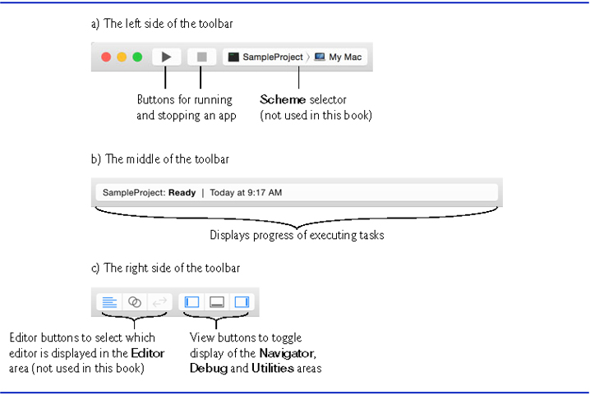
Figure 1.28 Xcode 7 Toolbar

Slide 140
1.10.3 Compiling and Running with Xcode on Mac O S X (9 of 15)
Step 4: Deleting the main.cpp File from the Project
You won’t use main.cpp in this test-drive, so you should delete the file.
In the Project navigator, right click the main.cpp file and select Delete.
In the dialog that appears, select Move to Trash to delete the file.

Slide 141
1.10.3 Compiling and Running with X code on Mac O S X (10 of 15)
Step 5: Adding the GuessNumber.cpp File into the Project
Add GuessNumber.cpp to the project.
In a Finder window, open the ch01 folder in the book’s examples folder, then drag GuessNumber.cpp onto the Guess Number folder in the Project navigator.
In the dialog that appears, ensure that Copy items if needed is checked, then click Finish.

Slide 142
1.10.3 Compiling and Running with X code on Mac O S X (11 of 15)
Step 6: Compiling and Running the Project
To compile and run the project so you can test-drive the application, click the run button at the left side of X code’s toolbar.
If the program compiles correctly, X code opens the Debug area (at the bottom of the Editor area) and executes the program in the right half of the Debug area (Figure 1.29).
The application displays “Please type your first guess.”, then displays a question mark (?) as a prompt on the next line.

Slide 143
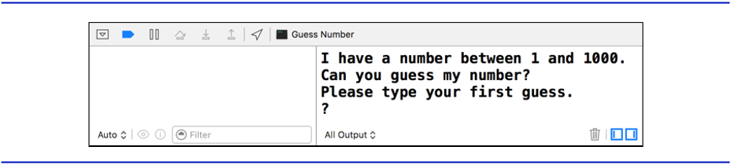
Figure 1.29 Debug Area Showing the Running Program

Slide 144
1.10.3 Compiling and Running with X code on Mac O S X (12 of 15)
Step 7: Entering Your First Guess
Click in the Debug area, then type 500 and press Return.
The application displays “Too low. Try again.” (Figure 1.30), meaning that the value you entered is less than the number the application chose as the correct guess.

Slide 145

Figure 1.30 Entering an Initial Guess and Receiving Feedback

Slide 146
1.10.3 Compiling and Running with X code on Mac O S X (13 of 15)
Step 8: Entering Another Guess
At the next prompt, enter 750 (Figure 1.31).
The application displays “Too low. Try again.”, because the value you entered once again is less than the correct guess.

Slide 147

Figure 1.31 Entering a Second Guess and Receiving Feedback

Slide 148
1.10.3 Compiling and Running with X code on Mac O S X (14 of 15)
Step 9: Entering Additional Guesses
Continue to play the game (Figure 1.32) by entering values until you guess the correct number.
When you guess correctly, the application displays “Excellent! You guessed the number.”

Slide 149
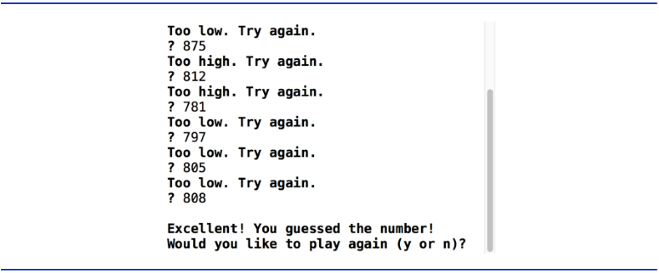
Figure 1.32 Entering Additional Guesses and Guessing the Correct Number

Slide 150
1.10.3 Compiling and Running with Xcode on Mac O S X (15 of 15)
Playing the Game Again or Exiting the Application
After you guess the correct number, the application asks if you’d like to play another game.
At the “Would you like to play again (y or n)?” prompt, entering the character y causes the application to choose a new number and displays the message “Please type your first guess.” followed by a question-mark prompt so you can make your first guess in the new game.
Entering the character n terminates the application. Each time you execute this application from the beginning (Step 6), it will choose the same numbers for you to guess.

Slide 151
1.11 Operating Systems
Operating systems
Software systems that make using computers more convenient for users, application developers and system administrators.
Provide services that allow each application to execute safely, efficiently and concurrently (i.e., in parallel) with other applications.
The software that contains the core components of the operating system is called the kernel.
Popular desktop operating systems include Linux, Windows and O S X (formerly called Mac O S X).
Popular mobile operating systems used in smartphones and tablets include Google’s Android, Apple’s i O S and Windows 10 Mobile.

Slide 152
1.11.1 Windows—A Proprietary Operating System (1 of 2)
Mid-1980s, Microsoft developed the Windows operating system, consisting of a graphical user interface built on top of D O S—an enormously popular personal-computer operating system of the time that users interacted with by typing commands.
Windows borrowed from many concepts (such as icons, menus and windows) developed by Xerox P A R C and popularized by early Apple Macintosh operating systems.

Slide 153
1.11.1 Windows—A Proprietary Operating System (2 of 2)
Windows 10 is Microsoft’s latest operating system—its features include enhancements to the Start menu and user interface, Cortana personal assistant for voice interactions, Action Center for receiving notifications, Microsoft’s new Edge web browser, and more.
Windows is a proprietary operating system—it’s controlled by Microsoft exclusively.
Windows is by far the world’s most widely used desktop operating system

Slide 154
1.11.2 Linux—An Open-Source Operating System (1 of 3)
Open-source software
A software development style that departs from the proprietary development that dominated software’s early years.
Individuals and companies contribute their efforts in developing, maintaining and evolving software in exchange for the right to use that software for their own purposes, typically at no charge.

Slide 155
1.11.2 Linux—An Open-Source Operating System (2 of 3)
Some key organizations in the open-source community are
the Eclipse Foundation (the Eclipse Integrated Development Environment helps programmers conveniently develop software)
the Mozilla Foundation (creators of the Firefox web browser)
the Apache Software Foundation (creators of the Apache web server used to develop web-based applications)
GitHub (which provides tools for managing open-source projects—it has millions of them under development).
Facebook, which was launched from a college dorm room and built with open-source software.

Slide 156
1.11.2 Linux—An Open-Source Operating System (3 of 3)
Linux
The most popular open-source operating system.
Developed by volunteers
Popular in servers, personal computers and embedded systems.
Source code is available to the public for examination and modification
Free to download and install.
Ability to completely customize the operating system to meet specific needs.

Slide 157
1.11.3 Apple’s O S X; Apple’s i O S for iPhone ®, iPad® and iPod Touch ® Devices (1 of 3)
In 1979, Steve Jobs and several Apple employees visited Xerox P A R C (Palo Alto Research Center) to learn about Xerox’s desktop computer that featured a graphical user interface (G U I).
That G U I served as the inspiration for the Apple Macintosh, launched with much fanfare in a memorable Super Bowl ad in 1984.

Slide 158
1.11.3 Apple’s O S X; Apple’s i O S for iPhone ®, iPad® and iPod Touch ® Devices (2 of 3)
Objective-C Programming Language
Created by Brad Cox and Tom Love at Step stone in the early 1980s, added capabilities for object-oriented programming (O O P) to the C programming language.
Steve Jobs left Apple in 1985 and founded NeXT Inc.
In 1988, NeXT licensed Objective-C from Step Stone and developed an Objective-C compiler and libraries which were used as the platform for the NeXTSTEP operating system’s user interface and Interface Builder—used to construct graphical user interfaces.

Slide 159
1.11.3 Apple’s O S X; Apple’s i O S for iPhone ®, iPad® and iPod Touch ® Devices (3 of 2)
Jobs returned to Apple in 1996 when Apple bought NeXT.
Apple’s O S X operating system is a descendant of NeXTSTEP.
Apple’s proprietary operating system, i O S, is derived from Apple’s O S X and is used in the iPhone, iPad and iPod Touch devices.
In 2014, Apple introduced its new Swift programming language, which became open source in 2015.
The i O S app-development community is gradually shifting from Objective-C to Swift.

Slide 160
1.11.4 Google’s Android
Android
Fastest growing mobile and smartphone operating system
Based on the Linux kernel and Java.
Open source and free.
Developed by Android, Inc., which was acquired by Google in 2005.
According to I D C, after the first six months of 2015, Android had 82.8% of the global smartphone market share, compared to 13.9% for Apple, 2.6% for Microsoft and 0.3% for Blackberry.
Used in numerous smartphones, e-reader devices, tablets, in-store touch-screen kiosks, cars, robots, multimedia players and more.
At the time of this writing there were more than 1.4 billion Android users.

Slide 161
1.12 The Internet and the World Wide Web (1 of 8)
In the late 1960s, A R P A—the Advanced Research Projects Agency of the United States Department of Defense—rolled out plans for networking the main computer systems of approximately a dozen A R P A-funded universities and research institutions.
The computers were to be connected with communications lines operating at speeds on the order of 50,000 bits per second, a stunning rate at a time when most people were connecting over telephone lines to computers at a rate of 110 bits per second.
A R P A proceeded to implement what quickly became known as the A R P A N E T, the precursor to today’s Internet. Today’s fastest Internet speeds are on the order of billions of bits per second with trillion-bits-per-second speeds on the horizon!

Slide 162
1.12 The Internet and the World Wide Web (2 of 8)
Although the A R P A N E T enabled researchers to network their computers, its main benefit proved to be the capability for quick and easy communication via what came to be known as electronic mail (e-mail).
This is true even on today’s Internet, with e-mail, instant messaging, file transfer and social media such as Facebook and Twitter enabling billions of people worldwide to communicate quickly and easily.
The protocol (set of rules) for communicating over the A R P A N E T became known as the Transmission Control Protocol (T C P).
T C P ensured that messages, consisting of sequentially numbered pieces called packets, were properly routed from sender to receiver, arrived intact and were assembled in the correct order.

Slide 163
1.12 The Internet and the World Wide Web (3 of 8)
The Internet: A Network of Networks
In parallel with the early evolution of the Internet, organizations worldwide were implementing their own networks for both intraorganization and interorganization communication.
A huge variety of networking hardware and software appeared.
One challenge was to enable these different networks to communicate with each other.
A R P A accomplished this by developing the Internet Protocol (I P), which created a “network of networks,” the current architecture of the Internet.
The combined set of protocols is now called T C P/I P.
As a result of business investement, bandwidth—the information-carrying capacity of communications lines—on the Internet has increased tremendously, while hardware costs have plummeted.

Slide 164
1.12 The Internet and the World Wide Web (4 of 8)
The World Wide Web (simply called “the web”) is a collection of hardware and software associated with the Internet that allows computer users to locate and view multimedia-based documents (documents with various combinations of text, graphics, animations, audios and videos) on almost any subject.
In 1989, Tim Berners-Lee of C E R N (the European Organization for Nuclear Research) began to develop a technology for sharing information via “hyperlinked” text documents.

Slide 165
1.12 The Internet and the World Wide Web (5 of 8)
Berners-Lee called his invention the HyperText Markup Language (H T M L).
He also wrote communication protocols such as HyperText Transfer Protocol (H T T P) to form the backbone of his new hypertext information system—the World Wide Web.
In 1994, Berners-Lee founded the World Wide Web Consortium (W3C, http://www.w3.org), devoted to developing web technologies.
One of the W3C’s primary goals is to make the web universally accessible to everyone regardless of disabilities, language or culture.

Slide 166
1.12 The Internet and the World Wide Web (6 of 8)
Web services are software components stored on one computer that can be accessed by an app (or other software component) on another computer over the Internet.
With web services, you can create mashups, which enable you to rapidly develop apps by combining complementary web services, often from multiple organizations and possibly other forms of information feeds.
Programmableweb (http://www.programmableweb.com/) provides a directory of over 11,150 A P I s and 7,300 mashups, plus how-to guides and sample code for creating your own mashups.

Slide 167
1.12 The Internet and the World Wide Web (7 of 8)
Ajax technology helps Internet-based applications perform like desktop applications.
Using Ajax, applications like Google Maps have achieved excellent performance and approach the look-and-feel of desktop applications.

Slide 168
1.12 The Internet and the World Wide Web (8 of 8)
The Internet is no longer just a network of computers—it’s an Internet of Things.
A thing is any object with an I P address and the ability to send data automatically over the Internet
Examples
a car with a transponder for paying tolls
a heart monitor implanted in a human
a smart meter that reports energy usage
mobile apps that can track your movement and location
smart thermostats that adjust room temperatures based on weather forecasts and activity in the home.

Slide 169
1.13 Some Key Software Development Terminology (1 of 2)
Figure 1.27 lists a number of buzzwords that you’ll hear in the software development community.

Slide 170
Figure 1.33 Software Technologies (1 of 3)
Technology | Description
Agile software development | Agile software development is a set of methodologies that try to get software implemented faster and using fewer resources. Check out the Agile Alliance (www.agilealliance.org) and the Agile Manifesto (http://www.agilemanifesto.org).
Refactoring | Refactoring involves reworking programs to make them clearer and easier to maintain while preserving their correctness and functionality. It’s widely employed with agile development methodologies. Many I D E s contain built-in refactoring tools to do major portions of the reworking automatically.
Design patterns | Design patterns are proven architectures for constructing flexible and maintainable object-oriented software. The field of design patterns tries to enumerate those recurring patterns, encouraging software designers to reuse them to develop better-quality software using less time, money and effort.

Slide 171
Figure 1.33 Software Technologies (2 of 3)
Technology | Description
LAMP | LAMP is an acronym for the open-source technologies that many developers use to build web applications inexpensively—it stands for Linux, Apache, My S Q L and P H P (or Perl or Python—two other popular scripting languages). My S Q L is an open-source database-management system. P H P is a popular open-source server-side “scripting” language for developing web applications. Apache is the most popular web server software. The equivalent for Windows development is W A M P—Windows, Apache, My S Q L and P H P.
Software as a Service (S a a S) | Software has generally been viewed as a product; most software still is offered this way. If you want to run an application, you buy a software package from a software vendor—often a C D, D V D or web download. You then install that software on your computer and run it as needed. As new versions appear, you upgrade your software, often at considerable cost in time and money. This process can become cumbersome for organizations that must maintain tens of thousands of systems on a diverse array of computer equipment. With Software as a Service (S a a S), the software runs on servers elsewhere on the Internet. When that server is updated, all clients worldwide see the new capabilities—no local installation is needed. You access the service through a browser. Browsers are quite portable, so you can run the same applications on a wide variety of computers from anywhere in the world. Salesforce. com, Google, Microsoft and many other companies offer S a a S.

Slide 172
Figure 1.33 Software Technologies (3 of 3)
Technology | Description
Platform as a Service (P a a S) | Platform as a Service (P a a S) provides a computing platform for developing and running applications as a service over the web, rather than installing the tools on your computer. Some P a a S providers are Google App Engine, Amazon EC2 and Windows Azure™.
Cloud computing | S a a S and P a a S are examples of cloud computing. You can use software and data stored in the “cloud”—i.e., accessed on remote computers (or servers) via the Internet and available on demand—rather than having it stored locally on your desktop, notebook computer or mobile device. This allows you to increase or decrease computing resources to meet your needs at any given time, which is more cost effective than purchasing hardware to provide enough storage and processing power to meet occasional peak demands. Cloud computing also saves money by shifting to the service provider the burden of managing these apps (such as installing and upgrading the software, security, backups and disaster recovery).
Software Development Kit (S D K) | Software Development Kits (S D K s) include the tools and documentation developers use to program applications.

Slide 173
1.13 Some Key Software Development Terminology (2 of 2)
Figure 1.28 describes software product-release categories.

Slide 174
Figure 1.34 Software Product-Release Terminology
Version | Description
Alpha | Alpha software is the earliest release of a software product that’s still under active development. Alpha versions are often buggy, incomplete and unstable and are released to a relatively small number of developers for testing new features, getting early feedback, etc.
Beta | Beta versions are released to a larger number of developers later in the development process after most major bugs have been fixed and new features are nearly complete. Beta software is more stable, but still subject to change.
Release candidates | Release candidates are generally feature complete, (mostly) bug free and ready for use by the community, which provides a diverse testing environment—the software is used on different systems, with varying constraints and for a variety of purposes.
Final release | Any bugs that appear in the release candidate are corrected, and eventually the final product is released to the general public. Software companies often distribute incremental updates over the Internet.
Continuous beta | Software that’s developed using this approach (for example, Google search or Gmail) generally does not have version numbers. It’s hosted in the cloud (not installed on your computer) and is constantly evolving so that users always have the latest version.

Slide 175
1.14 C++11 and C++14: The Latest C++ Versions (1 of 2)
C++11 (formerly called C++0x) was published by I S O/I E C in 2011.
The main goals were to
make C++ easier to learn,
improve library building capabilities
increase compatibility with the C programming language.
This version of the standard extended the C++ Standard Library and includes several features and enhancements to improve performance and security.

Slide 176
1.14 C++11 and C++14: The Latest C++ Versions (2 of 2)
The current C++ standard, C++14, was published by I S O/I E C in 2014.
Added several language features and C++ Standard Library enhancements, and fixed bugs from C++11.
For a list of C++11 and C++14 features and the compilers that support them, visit
http://en.cppreference.com/w/cpp/compiler_support
The next version of the C++ standard, C++17, is currently under development.
https://en.wikipedia.org/wiki/C%2B%2B17

Slide 177
1.15 Boost C++ Libraries (1 of 2)
The Boost C++ Libraries are free, open-source libraries created by members of the C++ community.
Boost has grown to over 100 libraries, with more being added regularly.

Slide 178
1.15 Boost C++ Libraries (2 of 2)
Regular expressions are used to match specific character patterns in text. They can be used to validate data to ensure that it’s in a particular format, to replace parts of one string with another, or to split a string.
Many common bugs in C and C++ code are related to pointers, a powerful programming capability that C++ absorbed from C.
Smart pointers help you avoid errors associated with traditional pointers.

Slide 179
1.16 Keeping Up-to-Date with Information Technologies
Figure 1.35 lists key technical and business publications that will help you stay up-to-date with the latest news, trends and technology.

Slide 180
Figure 1.35 Technical and Business Publications (1 of 2)
Publication | URL
AllThingsD | allthingsd.com
Bloomberg BusinessWeek | www.businessweek.com
C N E T | news.cnet.com
Communications of the A C M | cacm.acm.org
Computerworld | www.computerworld.com
Engadget | www.engadget.com
eWeek | www.eweek.com
Fast Company | www.fastcompany.com
Fortune | fortune.com
GigaOM | gigaom.com
Hacker News | news.ycombinator.com
I E E E Computer Magazine | www.computer.org/portal/web/computingnow/computer
InfoWorld | www.infoworld.com
Mashable | mashable.com
P C World | www.pcworld.com

Slide 181
Figure 1.35 Technical and Business Publications (2 of 2)
Publication | URL
S D Times | www.sdtimes.com
Slashdot | slashdot.org
Stack Overflow | stackoverflow.com
Technology Review | technologyreview.com
Techcrunch | techcrunch.com
The Next Web | thenextweb.com
The Verge | www.theverge.com
Wired | www.wired.com

Slide 182

Copyright

